Slide 1
The Waste & Resources Strategy Welcoming in a new era of resource focussed waste management policy Victoria Hutchin

Slide 2
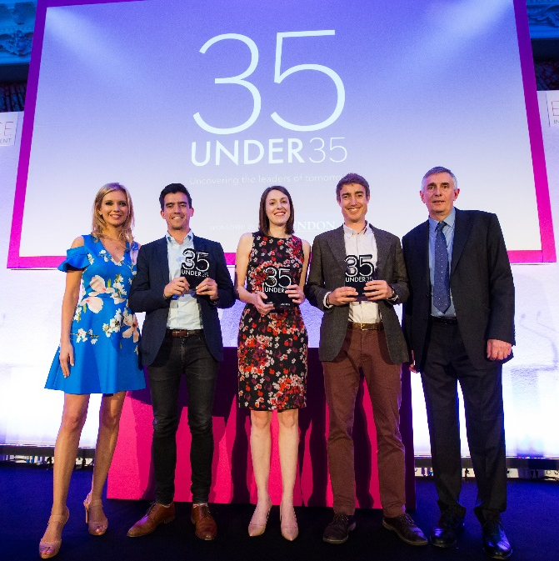
Welcome
Associate Waste & Resource Management Consultant
Top 3 in 35 under 35 Awards 2018
12 years of sector experience
Chartered Waste Manager and Chartered Environmentalist

Slide 3
Who are WYG?
WYG is an award-winning professional services firm operating from more than 50 locations across the UK, Europe, Africa and Asia
We serve our clients through six business streams:
International Development
Infrastructure & Built Environment
Programme & Project Management
Surveying & Asset Management
Environmental
Waste and Resource Management
Planning & Transport
https://www.wyg.com/consulting/environmental

Slide 4
Starting point
Recycling rate 44.9% (England)
90% (£700m) of cost of household recycling collections and processing covered by Council tax
10% (£73m) covered by producers (LARAC)
Phil Conran – Chair of advisory committee on packaging
Currently not about long-term sustainability
Focus on meeting that years’ target

Slide 5
Key Strategy Principles
To work towards making all packaging recyclable, reusable or compostable by 2025
Zero food waste to landfill by 2030
Eliminating avoidable plastic waste by 2042
Doubling resource productivity by 2050
Eliminating avoidable waste by 2050
The beginning of the end of the ‘buy, consume, throwaway’ linear ethos

Slide 6
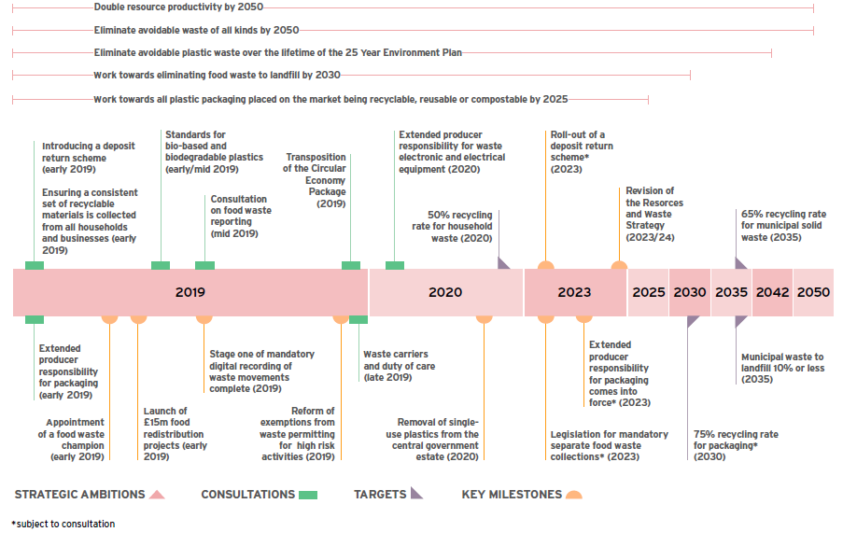
Key Milestones
Source: Our Waste, Our Resources: A Strategy for England, December 2018

Slide 7
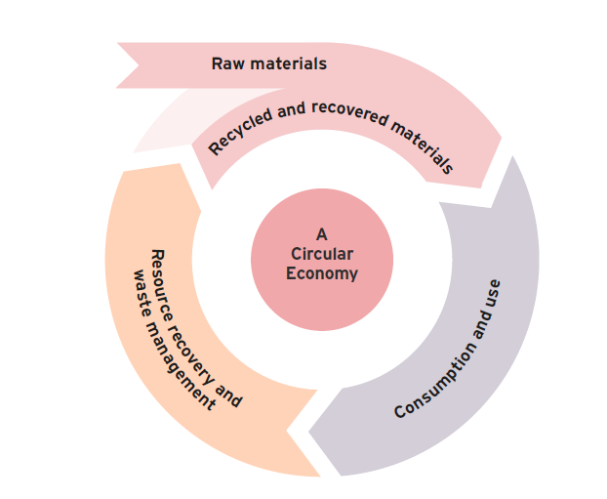
Challenging status quo
EPR and DRS – help guarantee waste products have a value at the end of life
Quantity and quality of materials available and stimulate demand in secondary market
Recycling targets for packaging
Tax on plastic packaging with <30% recycled content
Potential future Tax on incineration
Source: Our Waste, Our Resources: A Strategy for England, December 2018

Slide 8
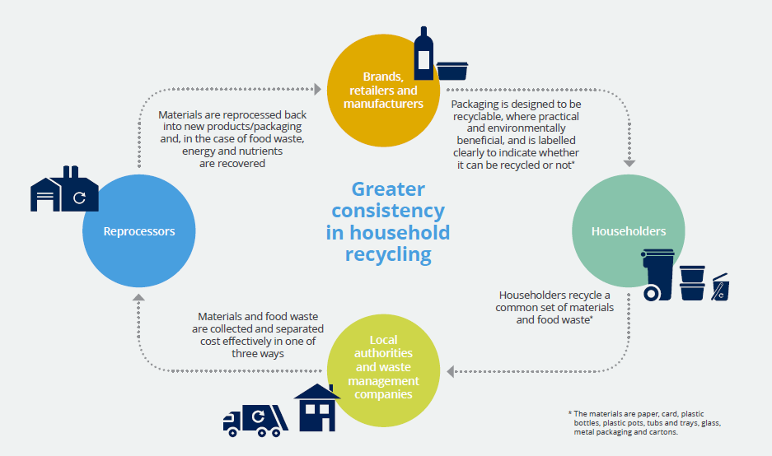
Material Consistency
Source: A Framework for greater consistency in household recycling in England, WRAP
Purpose: Deliver high quality
Notes:
Weekly food waste collections
Core suite of recyclable materials
Consultation on materials and systems
Separate glass?
Which systems are most effective at preserving material quality
Free garden waste?
Non-binding performance indicators
Quality of materials collected
Minimum service standards

Slide 9
Circular Economy Package
Notes:
Recycling more is not enough

Slide 10
Material Quality
Reform Packaging Waste Regulations
Easier to recycle
Consult on exports
Easier for consumers to know what to recycle
Review Packaging (Essential Requirements) Regulations 2015 by the end of 2020
When is separate collection necessary?
Role of Communications
Quality standards for compost and digestate – fully adopted
Notes:
Quality organics through clear communications by local authorities and waste managers
mandatory packaging labelling

Slide 11
LA Support
New Statutory responsibilities subject to assessment of new burdens
Increase revenue for LAs
Government to work with urban authorities to improve recycling
Pilots of co-collection of commercial & domestic waste
Zoned collections of commercial & domestic waste
Align National Planning Policy with Strategy
Two-tier authorities
Better sharing of assets
Agreed service standards
Review of cost sharing inc. recycling credits
Notes:
Not clear how new revenue will feed down
EPR?
DRS?

Slide 12
How might the funding work?
Income from EPR
More polluting / less recyclable products = higher producer cost
EPR = incentive to improve packaging
Potentially LESS INCOME PER ITEM as products improved
BUT
Potentially MORE ITEMS as more products are recyclable
EPR + Min recycled content
Creates demand for secondary materials
Notes:
- Incentive for eco-design

Slide 13
Deposit Return Schemes
Deposit at point of purchase, refunded when items are returned
Public awareness is relatively low – 66% (RECOUP)
59% think deposit will be 10p per container or more (RECOUP)
DRS income fed back into the recycling system
Align with Scotland and other devolved nations
On-the-go or more extensive?

Slide 14
Impact of DRS
Potential reduction in litter? Figures as high as 90%
Collective savings modelled to be as high as £35m a year
Zero Waste Scotland – Savings £50m – landfill tax and litter reduction
Public perception is good
Will the impact be greater in cities where DRS will be more accessible?

Slide 15
Impact of DRS
Potential reduction in kerbside material & income
Certain costs are fixed
Minimum collection resource level
Admin, management and overhead
Assets and infrastructure
Contractual terms
What will this mean for local recycling rates? And will this matter?
Notes:
A lot of factors contributing to LA collection resourcing including housing density, participation and set-out, waste and recycling generation per HH, traffic congestion

Slide 16
Extended Producer Responsibility
Recover full net cost
Implemented by 2023
Minimum recycled content 30% for plastic bottles (Tax by 2022)
Lower fees for products easier to recycle
Increase buyer awareness and influence purchasing decisions
Drive packaging innovation and gradually remove less recyclable / resource efficient products from market
Notes:
Includes impacts on Environment and Society

Slide 17
Waste Infrastructure
Waste Infrastructure Delivery Programme
£3 billion by 2042 on developing new waste infrastructure
Increasing capacity
Increasing investor confidence
Improving UK competitiveness in this market
Process more waste at home
Providing a large & stable supply of recyclable waste materials
Increasing the quality of the waste materials to be recycled
Improving demand for recycled materials & market stability
Levelling the playing field for UK – minimising illegal exports

Slide 18
HWRCs
Minimum standards at HWRCs
Reuse at HWRCs
Amend Waste Regulations for HWRCs
Reuse guidance
Targets for LAs – set by Government
Requirements for LAs to set own targets
Reporting to encourage greater provision of reuse facilities

Slide 19
Waste Minimisation
Implementation of food labelling guidance (developed 2017)
Food redistribution before it becomes waste
Amounts to 250 million meals per annum
£15 million pilot scheme to be launched in 2019
Appointment of Food Surplus and Waste Champion
£10m collaboration fund
E.g. alternative commercial outlets for non-specification goods
OR
Shortened supply chains

Slide 20
Prevention of Crime
Mandating digital recording of waste movements – subject to consultation
Easier for HH to understand & comply with duty of care
Intelligence sharing – police, local authorities, HMRC & industry
Fly-tipping toolkit = web-based tools
Changes to waste exemptions
Possible tax registration checks
Creation of joint unit for waste crime

Slide 22
victoria.hutchin@wyg.com
If you would like any more information, please visit www.wyg.com

