Slide 1
Tools to Address Challenges in Local Authority Waste Management
Stuart Henshaw,
Business Development Director
Notes:
1

Slide 2
Tools to respond to Performance Improvements in the Government Strategy
Responding to the “consistent set of recyclable materials from homes” - 2019
Composting and Recycling rates need to go up
50% recycling rate by 2020
Deposit Return Scheme 2023 – 4 years time – plastic up, or down?
Mandatory Food Waste Collections 2023 – 4 years time – fleet renewals 6/7 year cycle Food pods v food vehicles?
If all packaging recyclable by 2025
more recycling – less residual

Slide 3
Operational Questions in Response to the Government Strategy
What new services do we have to provide?
What services can we still provide?
What needs to change?
Where and how should services be provided?
Can we charge for any new/existing services?
New Fleet?/what vehicles, when – what type/size?
Crew Requirements
How do we afford these services?

Slide 4
Technology Solutions from Integrated Skills
The world’s most intelligent routing system
In-cab solution for precision route navigation, reporting and two-way messaging
Online route management, operations monitoring & plan vs actual
For dynamic and variable route planning
A smartphone app for the improved management of recycling & waste collections

Slide 5
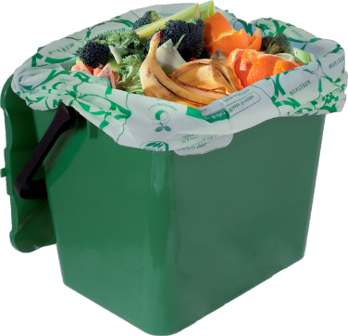
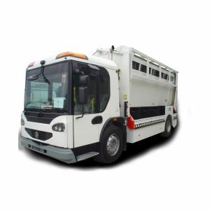
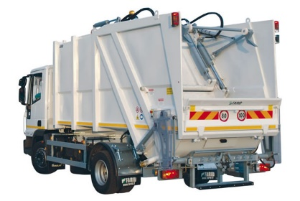
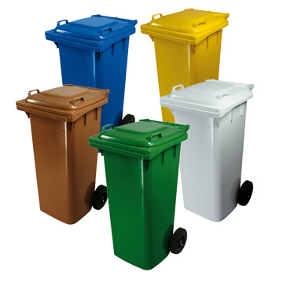
Responding to the New Waste Strategy
Food waste collections
RouteSmart can design dedicated food waste collections and model the impact on residual collections
Collection frequencies
RouteSmart can model the requirements of weekly, fortnightly, 3-weekly & 4-weekly collections
Increased packaging recovery
RouteSmart can model variations to container types and scale up and down for increased volumes of different waste streams
Waste treatment options
RouteSmart can model the impact of changes to waste disposal e.g. impact of delivering to EfW sites vs WTS

Slide 6
A Technological Solution from Integrated Skills
RouteSmart is capable of solving the most complex routing challenges with the highest degree of precision and processing performance
RouteSmart can be used as a tool to model options, collection methodologies, shift patterns, depot & disposal arrangements and property growth
RouteSmart generates evidence and provides confidence for decision-making
RouteSmart can model cross-boundary working and compare the relative efficiency of multiple solutions

Slide 7
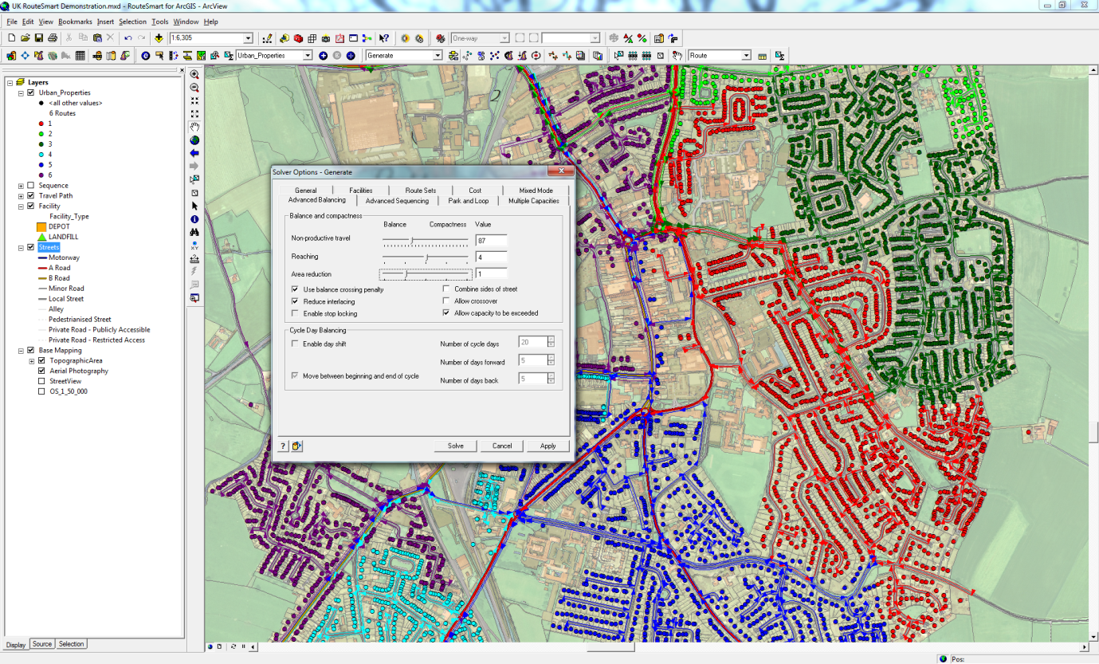
RouteSmart Route Optimisation Software
REDUCE time and mileage
INCREASE productivity
IMPROVE efficiency
LOWER CO₂ footprint
BALANCE workloads
MODEL new scenarios
OPTIMISE resources
EVIDENCE

Slide 8
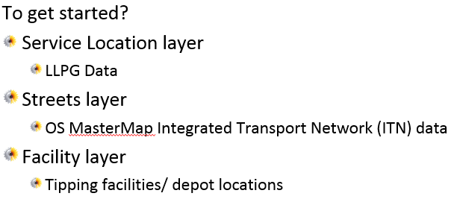
RouteSmart Route Optimisation Software
REDUCE time and mileage
INCREASE productivity
IMPROVE efficiency
LOWER CO₂ footprint
BALANCE workloads
MODEL new scenarios
OPTIMISE resources
EVIDENCE

Slide 9
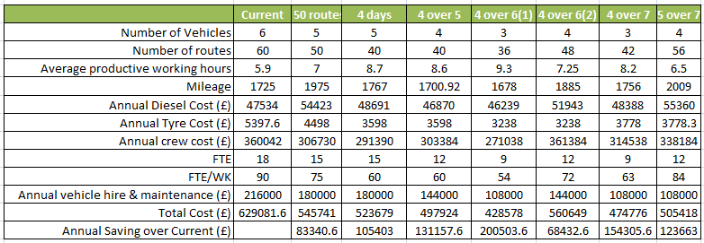
Rapid Modelling Options Example - Shift Patterns
Notes:
This work was for a client. RS can tell you all almost this (you will need to know your vehicle purchase cost) and compare the difference. See next slide...

Slide 10
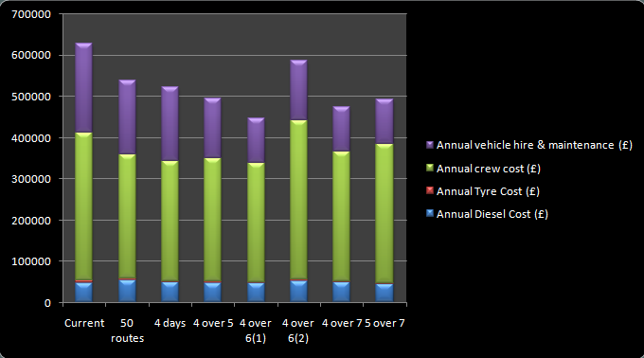
Rapid Modelling Options Example - Shift Patterns
Notes:
Graphical representation of the previous. This outcome is client specific based on their routes, costs staffing etc but illustrates the modelling capability of the software.

Slide 11
Recycling routes - Comparison of Models
Recycling Modelling
Integrated Skills
Scenario | Total No. Routes | Travel Time (hh:mm) | Service Time (hh:mm) | Facility Time (hh:mm) | Break Time (hh:mm) | Total Time (hh:mm) | Average Route Total Time (hh:mm) | Total No. Tips | Total Distance (miles) | Location Count | Annual Mileage
Current (Mirrored) | 56 | 37:23 | 312:48 | 28:45 | 37:20 | 416:36 | 7:26 | 115 | 1,755 | 88,330 | 45,630
Current Balanced (Mirrored) | 56 | 36:34 | 312:48 | 28:00 | 37:20 | 415:00 | 7:25 | 112 | 1,735 | 88,330 | 45,110
Current Days New Routes (Mirrored) | 56 | 36:47 | 312:48 | 28:00 | 37:20 | 415:14 | 7:25 | 112 | 1,728 | 88,330 | 44,928
New Days New Routes (Mirrored) | 56 | 36:57 | 312:48 | 28:00 | 37:20 | 415:22 | 7:25 | 112 | 1,732 | 88,330 | 45,032
Current Days - 12 New Routes (Un-mirrored) | 48 | 31:35 | 312:48 | 24:15 | 32:00 | 400:55 | 8:21 | 97 | 1,595 | 88,330 | 41,470

Slide 12
Comparison of Service Models - Current

Slide 13
Comparison of Service Models – Current Balanced

Slide 14
Collection Days stay the same – but new routes

Slide 15
Clean Sheet (new days) new routes

Slide 16
Model shift patterns – less vehicles

Slide 17
Why is Quality Service Important?
There has been a revolution
Parcel and delivery industry
and its technology is re-shaping public expectations of quality service

Slide 18
What is Quality Service? View from 25 authorities
Raising and maintaining service quality & communications
Contact is easy
Providing services people need/like
Provided regularly and reliably ‘as expected’
Public know what and when to expect the service
Authority is responsive
‘More’ information is available about the service they receive
Public are told if something will not happen or about changes
Performance indicators

Slide 19
Improving Performance - knowing what you are doing
Raising and maintaining service quality & communications both internally and to the public through Connected Technologies
Does everyone know what should happen?
Does everyone know that it happened?
How would people know if it didn’t happen?
Who knows why it didn’t happen?
Is there any action to take next?
Do we need to communicate anything with the customer as a result?
Key – visibility for all and SSOT

Slide 20
Technology Solutions from Integrated Skills
The world’s most intelligent routing system
In-cab solution for precision route navigation, reporting and two-way messaging
Online route management, operations monitoring & plan vs actual
For dynamic and variable route planning
A smartphone app for the improved management of recycling & waste collections

Slide 21
Conclusion
Better Performance
1. local authorities changing gear with new Strategy targets
2. Better Service Visibility – reducing double, treble handling, SSOT -single source of truth
3. Service Improvement Planning
Better Service Quality - communication with the public – “there has been a revolution”
Partner with Companies who can help

